Slide 1


Is music a natural language?
Sebastian Chwilczyński
universal language
of mankind
Henry Wadsworth

Slide 2

What are we going to do?
8HT T ?T DR R HR 8DM ?M <MQ Q F HO O MO <H FH AM CH HM MO AH AHQ CT @MR R FR HR MT @HV FY >MX X E LT T MT T >HT ER <MQ E EO HM M :L HL H 9HM M AM HT
Entropy
Deep
Learning
DATA
PROCESSING
EXPERIMENTS

Slide 3
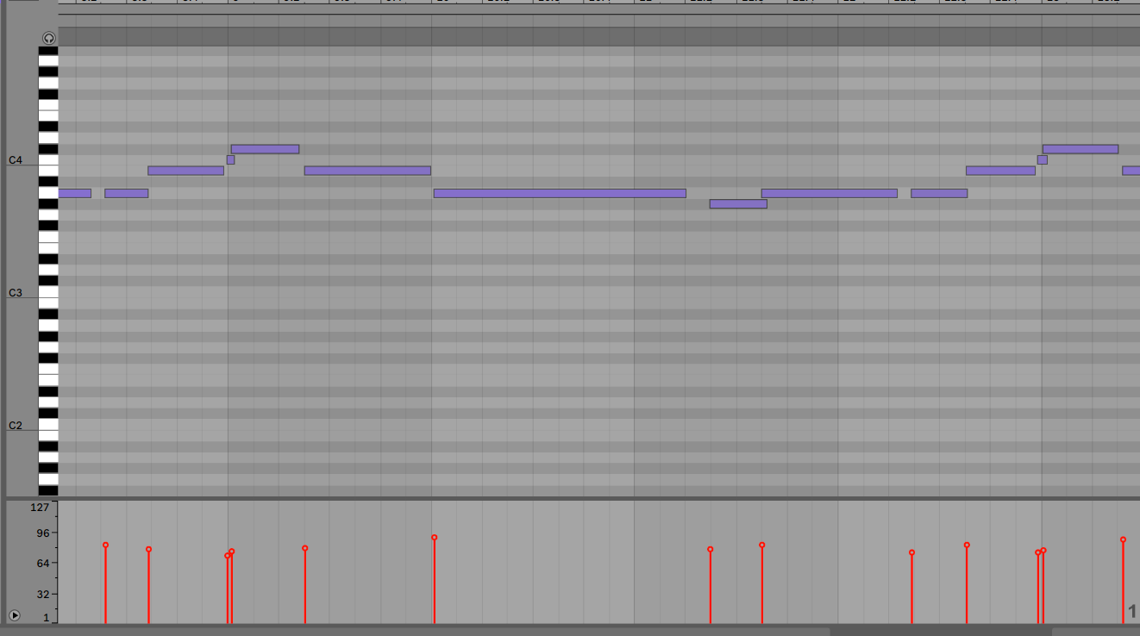
What is midi?
Pitch

Slide 4
What is midi?
Pitch
Velocity

Slide 5
What is midi?
Pitch
NoteOn
Velocity

Slide 6
What is midi?
Pitch
Note Off
NoteOn
Velocity

Slide 7
Lets gather some data!
Available datasets:
Lakh dataset (140 000 songs, all genres)
MAESTRO dataset (200 hours of midi and wave, classical music
Nottingham Music (1000 piano MIDI songs, nice to start with)
And many more but ....

Slide 8
Since we want to measure entropy for each genre or even artist separately
we need something like...

Slide 9
.
└── genres /
├── rock/
│ ├── artist_1/
│ │ ├── song_1.mid
│ │ └── song_2.mid
│ └── artist_2/
│ └── song_1.mid
├── jazz/
│ └── artist_1
├── blues
└── pop

Slide 10
Web scraping
import requests #to send HTTP requests

Slide 11
Web scraping
import requests #to send HTTP requests
import BeautifulSoup #to parse HTML files

Slide 12
Web scraping
import requests #to send HTTP requests
import BeautifulSoup #to parse HTML files
import selenium #to fire an event in browser if needed

Slide 13
Web scraping
import requests #to send HTTP requests
import BeautifulSoup #to parse HTML files
import selenium #to fire an event in browser if needed
html = requests.get(page with MIDI files)

Slide 14
Web scraping
import requests #to send HTTP requests
import BeautifulSoup #to parse HTML files
import selenium #to fire an event in browser if needed
html = requests.get(page with MIDI files)
soup = BeautifulSoup(html.content, "html.parser")

Slide 15
Web scraping
import requests #to send HTTP requests
import BeautifulSoup #to parse HTML files
import selenium #to fire an event in browser if needed
html = requests.get(page with MIDI files)
soup = BeautifulSoup(html.content, "html.parser")
for genre in soup.find_all("genre"):
for artist in genre.find_all("artist"):
for song in artist.find_all("songs"):

Slide 16
Web scraping
import requests #to send HTTP requests
import BeautifulSoup #to parse HTML files
import selenium #to fire an event in browser if needed
html = requests.get(page with MIDI files)
soup = BeautifulSoup(html.content, "html.parser")
for genre in soup.find_all("genre"):
for artist in genre.find_all("artist"):
for song in artist.find_all("songs"):
if song.click_needed: selenium.click()
song.get()

Slide 17
Dataset
Downloaded only songs from artists that was tagged with just one genre (Alicia keys has rap tag).

Slide 18
Dataset
Downloaded only songs from artists that was tagged with just one genre (Alicia keys has rap tag).
almost 8 thousand files overall:
3000 rock songs
2000 pop songs
1000 jazz songs
1300 country songs
600 blues songs

Slide 19
A few words on copyright
Public domain (canon in D):
you can do whatever you want.

Slide 20
A few words on copyright
Public domain (canon in D):
you can do whatever you want.
Otherwise, if you train a:
discriminative model - this is perfectly legal (Author’s Guild v. Google)

Slide 21
A few words on copyright
Public domain (canon in D):
you can do whatever you want.
Otherwise, if you train a:
discriminative model - this is perfectly legal (Author’s Guild v. Google)
generative model that could be used to generate new art this is not clear yet.

Slide 22
MIDI -> binary matrix
pitch
[[1, 0, 0, 0, 0, 1, 1]
[0, 1, 1, 0, 1, 0, 1]
[0, 0, 0, 1, 0, 0, 0]
[1, 0, 0, 1, 0, 0, 1]]
time

Slide 23
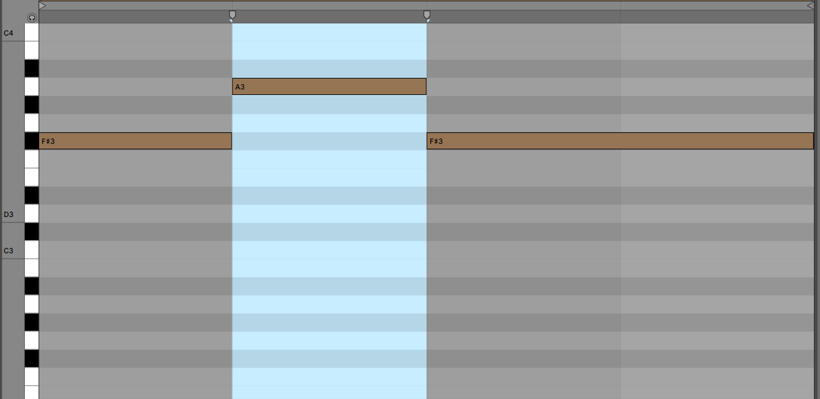
Resolution
One bar of the song is binned into 4 parts.

Slide 24
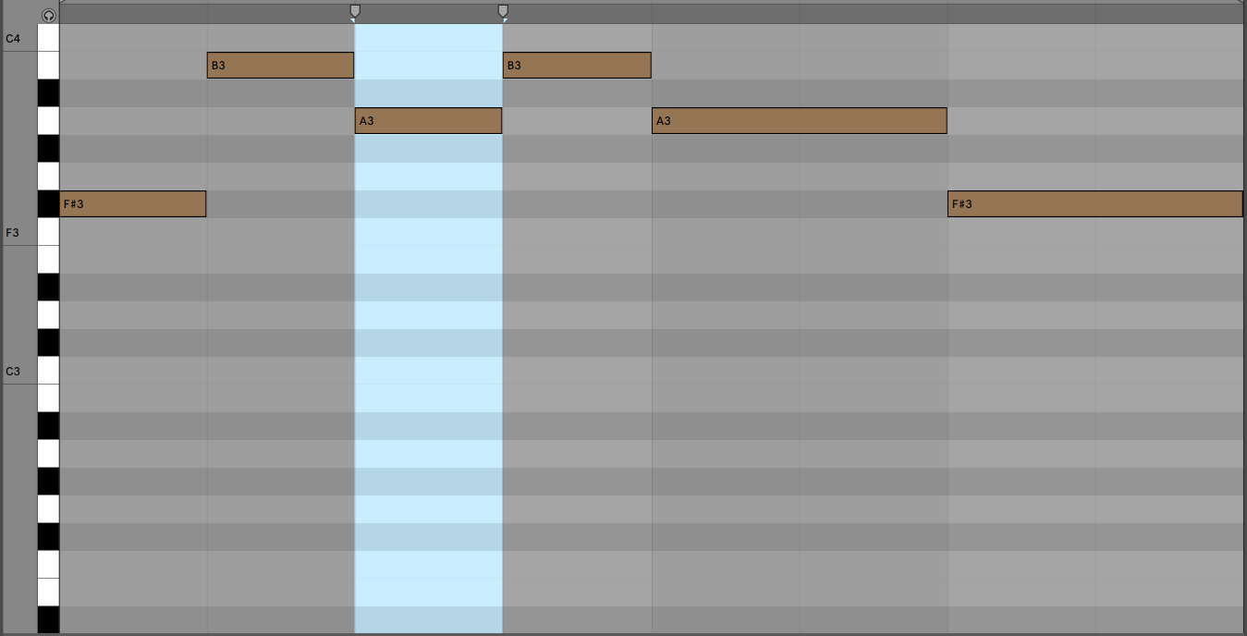
Resolution
One bar of the song is binned into 8 parts.

Slide 25
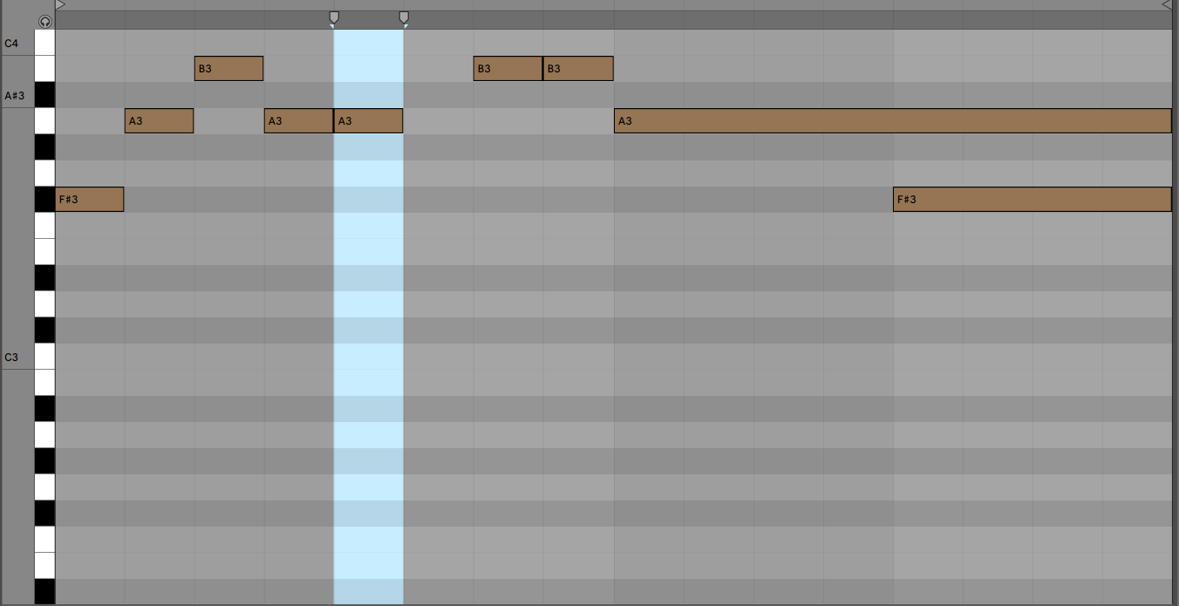
Resolution
One bar of the song is binned into 16 parts.

Slide 26
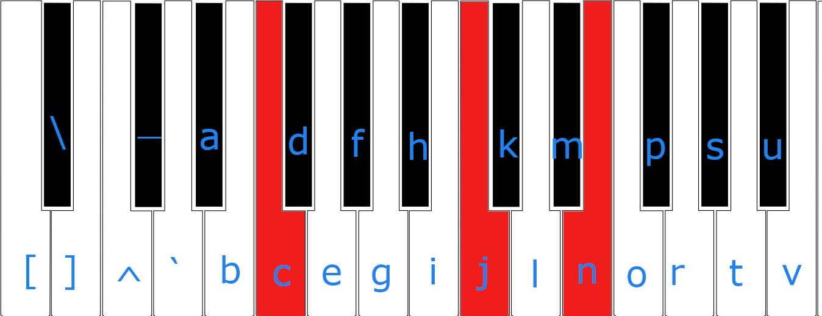
One timestep
[0,0,0, 0,0,0,0,0, 1,0,0,0,0,0,0, 1,0,0,0,1, 0,0,0,0,0,0]
cjn

Slide 27
Representation 1
R JR JR R :FR :FR AH AH <M <M M FM FM HQ HQ Q MQ MQ <HO <HO FM FM 5<AEM 5<AEM 5<AEM 5<AEM 5<AEM 5<AEM 5<AEM 5<AEM 5<AEM 5<AEM 5<AE 5<AE 5<AE 5<AE 5<AE

Slide 28
Representation 1
R JR JR R :FR :FR AH AH <M <M M FM FM HQ HQ Q MQ MQ <HO <HO FM FM 5<AEM 5<AEM 5<AEM 5<AEM 5<AEM 5<AEM 5<AEM 5<AEM 5<AEM 5<AEM 5<AE 5<AE 5<AE 5<AE 5<AE
It seems that this text could be
somehow compressed!

Slide 29
Lossy compression
R JR JR R :FR :FR AH AH <M <M M FM FM HQ HQ Q MQ MQ <HO <HO FM FM 5<AEM 5<AEM 5<AEM 5<AEM 5<AEM 5<AEM 5<AEM 5<AEM 5<AEM 5<AEM 5<AE 5<AE 5<AE 5<AE 5<AE
R JR R :FR AH <M M FM HQ Q MQ <HO FM 5<AEM 5<AE
With this representation we track changes.
Useful for calculating entropy!

Slide 30
Lossless compression
R JR JR R :FR :FR AH AH <M <M M FM FM HQ HQ Q MQ MQ <HO <HO FM FM 5<AEM 5<AEM 5<AEM 5<AEM 5<AEM 5<AEM 5<AEM 5<AEM 5<AEM 5<AEM 5<AE 5<AE 5<AE 5<AE 5<AE
R 1 JR 2 R 1 :FR 2 AH 2 <M 2 M 1 FM 2 HQ 2 Q 1 MQ 2 <HO 2 FM 2 5<AEM 10 5<AE 5
We can predict sequence of notes and number of repetition at one step!

Slide 31
Can we do any better?

Slide 32
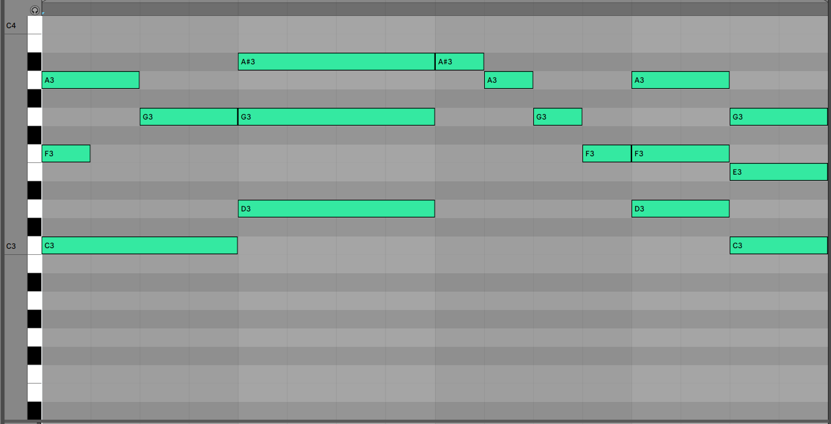
Representation 2
unit of time
at time 0 note 50 is played for 4 units of time, note 55 for 1 and 59 for 2. Then we wait for 2 units of time.
Current coding: n50 t4 n55 t1 n59 t2 w t2

Slide 33
Representation 2
unit of time
at time 2 note 57 is played for 2 units of time and we wait for 2 next units.
at time 4 notes 52, 57 and 60 are played all for 4 units of time and we wait 4.
Current coding: n50 t4 n55 t1 n59 t2 w t2 n57 t2 w t2 n52 t4 n57 t4 n60 t4 w t4

Slide 34

Conditional entropy
how unexpected the transistion between last 2 chords is?
a G F E->a
a G F E -> F
a G F E -> bdim

Slide 35

Conditional entropy
how unexpected the transistion between last 2 chords is?
a G F E->a
a G F E -> F
a G F E -> bdim
event to
be predicted
condition

Slide 36
Conditional entropy
how unexpected the transistion between last 2 chords is?
a G F E->a
P(X=a | Y = aGFE) = 10/16
a G F E -> F
P(X=F | Y = aGFE) = 5/16
a G F E -> bdim
P(X=bdim | Y=aGFE) = 1/16
event to
be predicted
condition

Slide 37
Conditional entropy
how unexpected the transistion between last 2 chords is?
a G F E->a
P(X=a | Y = aGFE) = 10/16
a G F E -> F
P(X=F | Y = aGFE) = 5/16
a G F E -> bdim
P(X=bdim | Y=aGFE) = 1/16
The smaller probability the more shocked we are that something happened. How to express it?

Slide 38
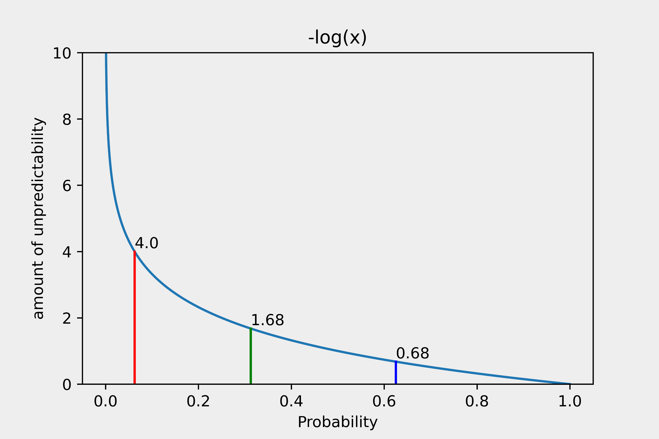
Conditional entropy
P(X=a | Y = aGFE) = 10/16
P(X=F | Y = aGFE) = 5/16
P(X=bdim | Y=aGFE) = 1/16

Slide 39
Conditional entropy
How much are we suprised on average?
P(X=a | Y = aGFE)*-log(P(X=a | Y = aGFE)) +
P(X=F | Y = aGFE)*-log(P(X=F | Y = aGFE)) +
P(X=bdim | Y=aGFE)*-log(P(X=bdim| Y=aGFE)) =

Slide 40
Conditional entropy
How much are we suprised on average?
P(X=a | Y = aGFE)*-log(P(X=a | Y = aGFE)) +
P(X=F | Y = aGFE)*-log(P(X=F | Y = aGFE)) +
P(X=bdim | Y=aGFE)*-log(P(X=bdim| Y=aGFE)) =
0.62*0.68 + 0.31*1.68 + 0.06*4.0 = 1.1824

Slide 41
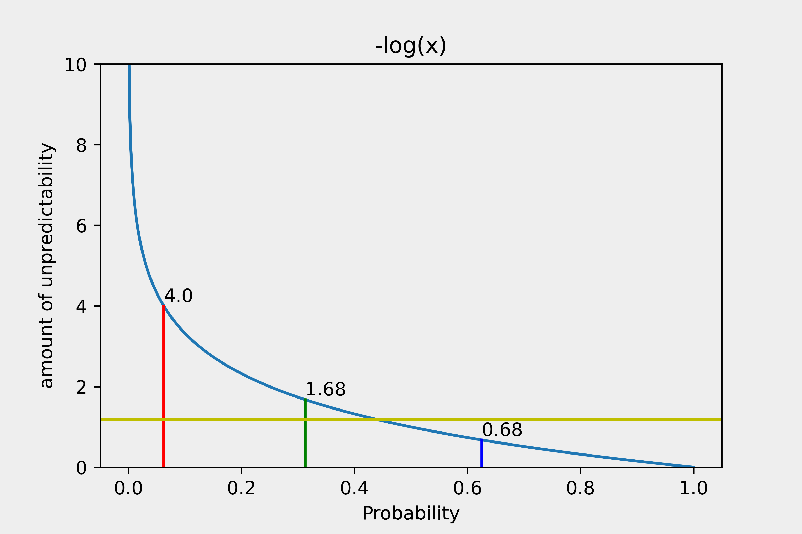
Conditional entropy
P(X=a | Y = aGFE) = 10/16
P(X=F | Y = aGFE) = 5/16
P(X=bdim | Y=aGFE) = 1/16
H(X|Y) = 1.1824

Slide 42
Conditional entropy
H(X|Y) = E-log(P(X|Y))
Conditional entropy is expected uncertainty about variable X having information about variable Y

Slide 43
Representation recap
R JR JR R :FR :FR AH AH <M <M M FM FM HQ HQ Q MQ MQ <HO <HO FM FM 5<AEM 5<AEM 5<AEM 5<AEM 5<AEM 5<AEM 5<AEM 5<AEM 5<AEM 5<AEM 5<AE 5<AE 5<AE 5<AE 5<AE
R JR R :FR AH <M M FM HQ Q MQ <HO FM 5<AEM 5<AE
With this representation we track changes.
Useful for calculating entropy!

Slide 44
expectations...

Slide 45
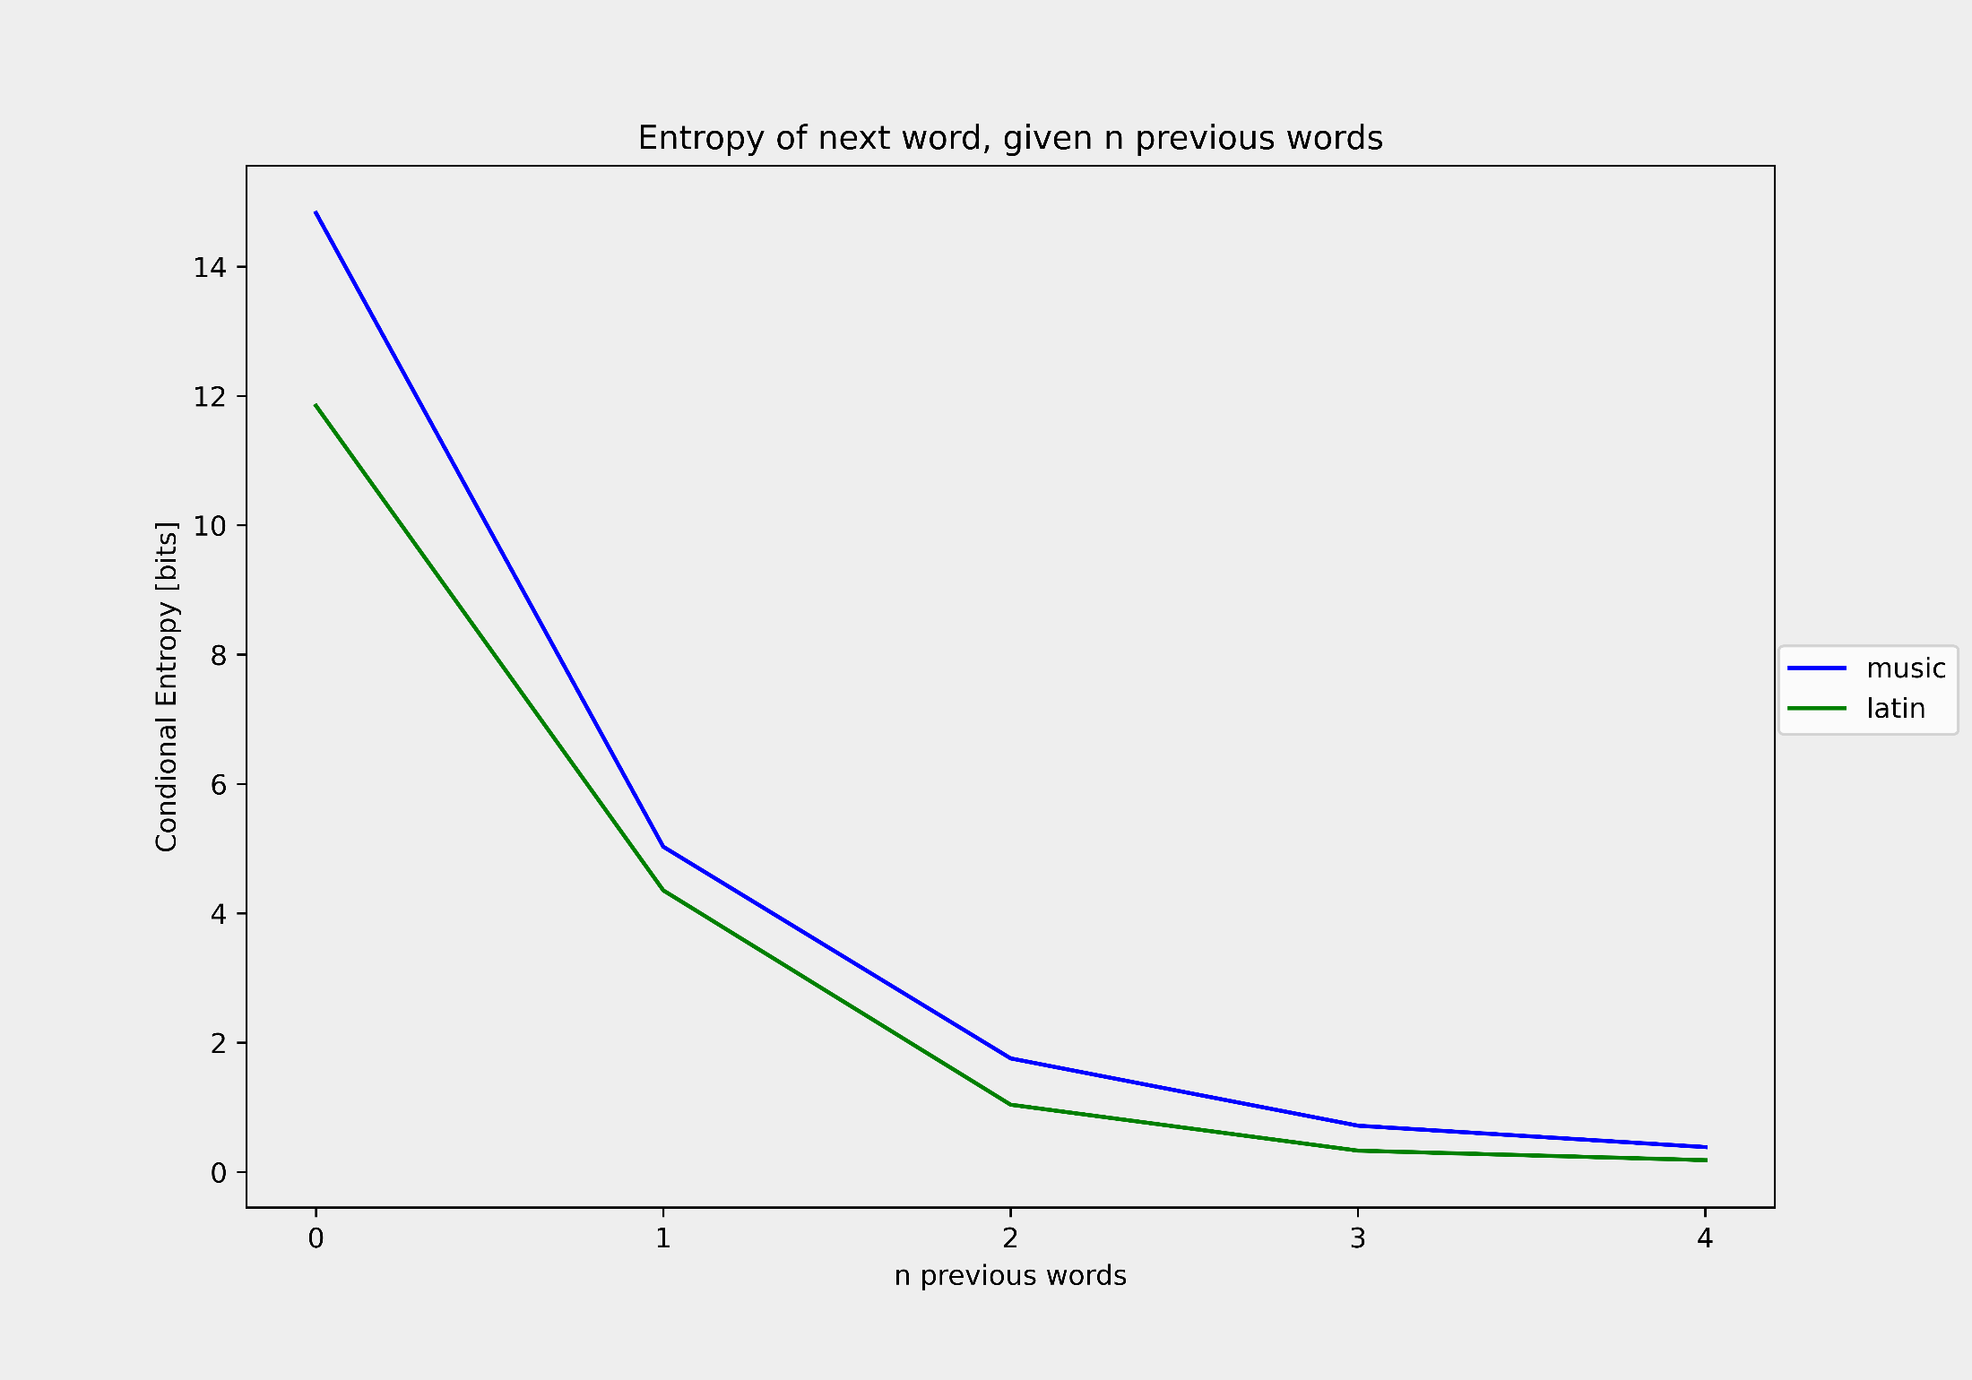
Latin vs music
Music corpus consist of: 89 different characters and 1,283,414 different words
Latin corpus consist of: 27 different
characters and 163,577 different words

Slide 46
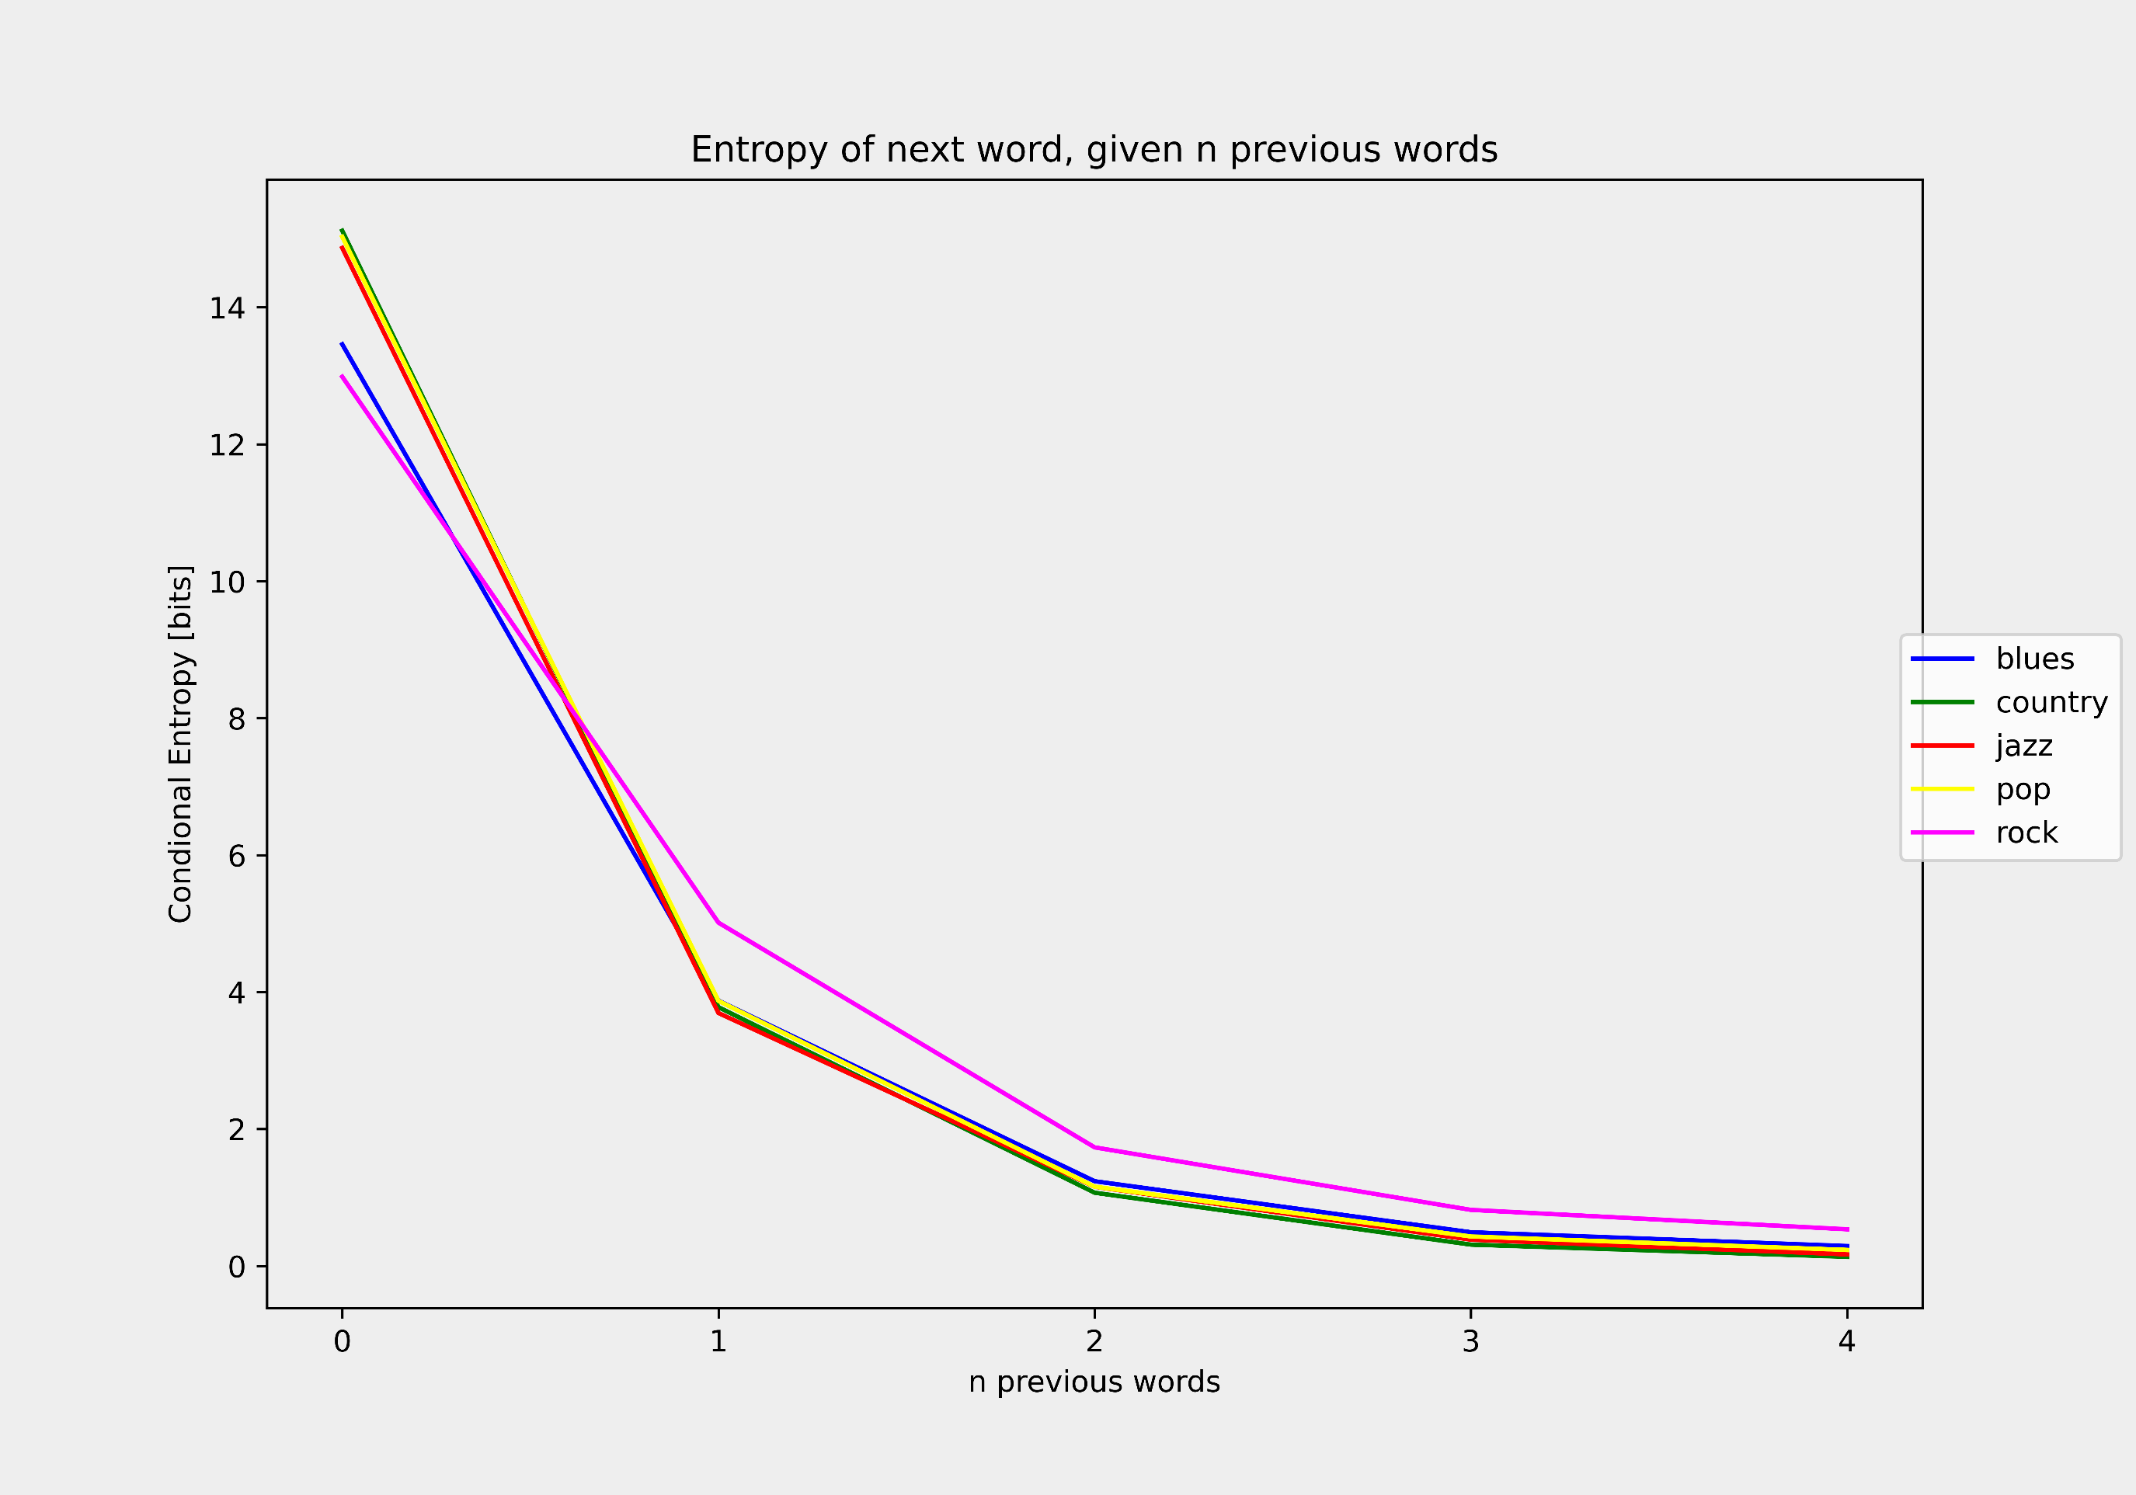
Genres comparison

Slide 47
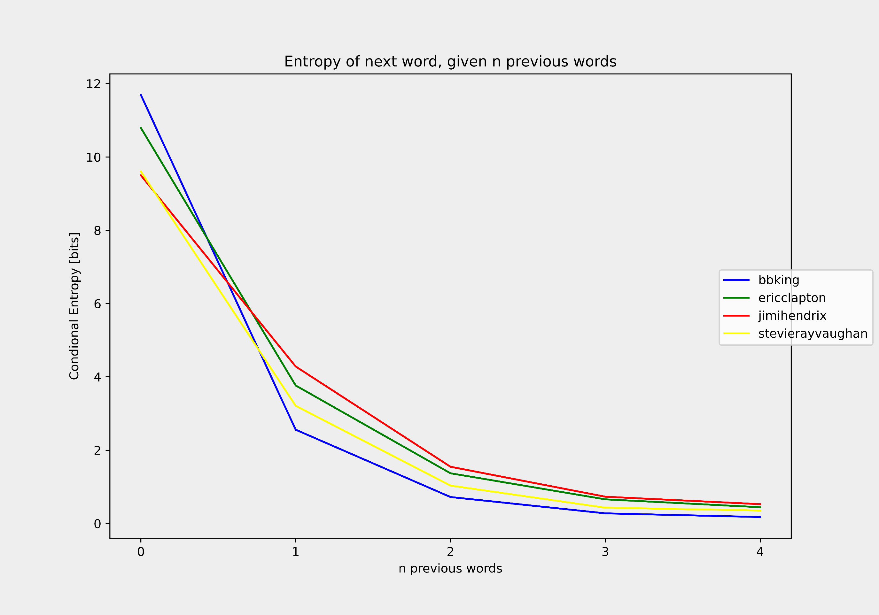
Artists within genre comparison

Slide 48
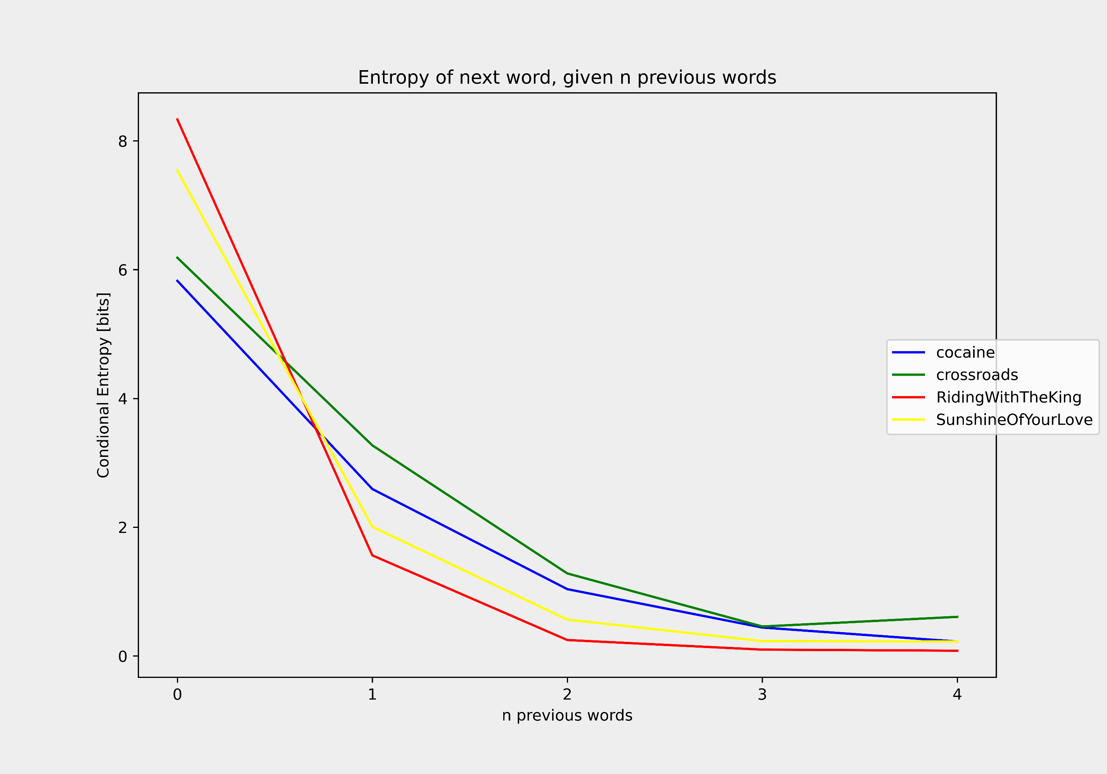
Songs within artist comparison

Slide 49
verdict

Slide 50
verdict
Music is a natural language!

Slide 51
Deep Learning approach
We will use LSTM architecture.

Slide 52
Deep Learning approach
We will use LSTM architecture.
The problem is modeled as a sequence to sequence task. Where input is a song and expected output is the same song shifted by one unit of time.

Slide 53
Deep Learning approach
We will use LSTM architecture.
The problem is modeled as a sequence to sequence task. Where input is a song and expected output is the same song shifted by one unit of time.
Three possible baselines will be tried, then the best approach will be trained using SOTA model

Slide 54
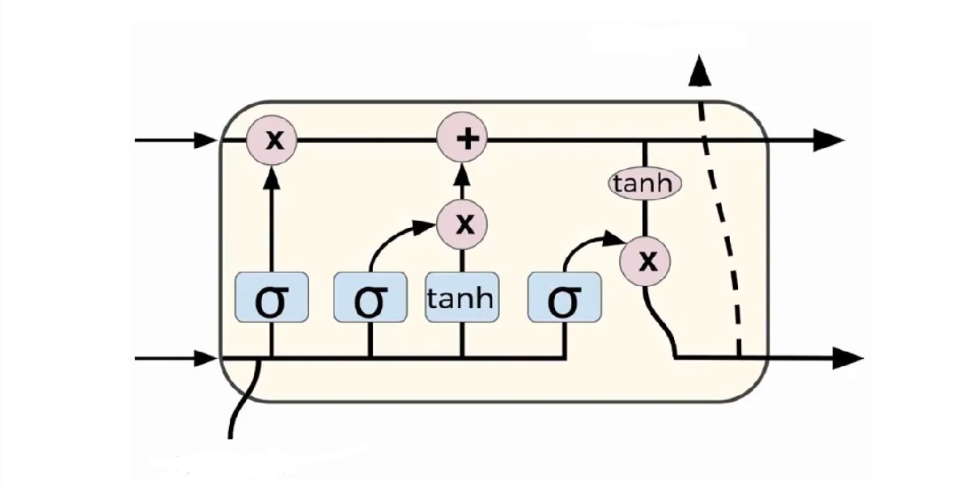
LSTM
What to play next
Memory about
previous parts
of the song
What I've played in the few previous steps.
What I've played in
the previous step

Slide 55
Input vs target
during training
Input: <?FK :?FK ?FK <?FK ?FK 3?FK ?FK 5?AHM 5AHM 5A 5AHM AHM ?AFK AHM 0A
Target: :?FK ?FK <?FK ?FK 3?FK ?FK 5?AHM 5AHM 5A 5AHM AHM ?AFK AHM 0A A5?

Slide 56
Input vs target
during training
Input: <?FK :?FK ?FK <?FK ?FK 3?FK ?FK 5?AHM 5AHM 5A 5AHM AHM ?AFK AHM 0A
Target: :?FK ?FK <?FK ?FK 3?FK ?FK 5?AHM 5AHM 5A 5AHM AHM ?AFK AHM 0A A5?
during inference
Input:
Target: some wonderful song

Slide 57
But wait... LSTM for a given sequence will
always produce the same output.

Slide 58
Output as a probability distribution
Network output:
[-5.0, 3.0, 3.5, 2.5, 1.0]

Slide 59
Output as a probability distribution
Network output:
[-5.0, 3.0, 3.5, 2.5, 1.0]
Divide by temperature (to make distribution more uniform or more peaked):
[-2.5, 1.5, 1.75, 1.25, 0.5]

Slide 60
Output as a probability distribution
Network output:
[-5.0, 3.0, 3.5, 2.5, 1.0]
Divide by temperature (to make distribution more uniform or more peaked):
[-2.5, 1.5, 1.75, 1.25, 0.5]
Pass it through softmax or sigmoid to have probabilities:
[0.01, 0.29, 0.37, 0.23, 0.10]

Slide 61
Output as a probability distribution
Network output:
[-5.0, 3.0, 3.5, 2.5, 1.0]
Divide by temperature (to make distribution more uniform or more peaked):
[-2.5, 1.5, 1.75, 1.25, 0.5]
Pass it through softmax or sigmoid to have probabilities:
[0.01, 0.29, 0.37, 0.23, 0.10]
Sample from this distribution:
[1]

Slide 62
baseline 1
We will use this representation first:
R JR JR R :FR :FR AH AH <M <M M FM FM HQ HQ Q MQ MQ <HO <HO FM FM 5<AEM 5<AEM 5<AEM 5<AEM 5<AEM 5<AEM 5<AEM 5<AEM 5<AEM 5<AEM 5<AE 5<AE 5<AE 5<AE 5<AE

Slide 63
baseline 1
We will use this representation first:
R JR JR R :FR :FR AH AH <M <M M FM FM HQ HQ Q MQ MQ <HO <HO FM FM 5<AEM 5<AEM 5<AEM 5<AEM 5<AEM 5<AEM 5<AEM 5<AEM 5<AEM 5<AEM 5<AE 5<AE 5<AE 5<AE 5<AE
Within each word, order of notes doesn't matter!

Slide 64
baseline 1
We will use this representation first:
R JR JR R :FR :FR AH AH <M <M M FM FM HQ HQ Q MQ MQ <HO <HO FM FM 5<AEM 5<AEM 5<AEM 5<AEM 5<AEM 5<AEM 5<AEM 5<AEM 5<AEM 5<AEM 5<AE 5<AE 5<AE 5<AE 5<AE
Within each word, order of notes doesn't matter!
So this problem is basically a multilabel classification task at each timestep.

Slide 65
baseline 2
We will use lossless compression representation:
R 1 JR 2 R 1 :FR 2 AH 2 <M 2 M 1 FM 2 HQ 2 Q 1 MQ 2 <HO 2 FM 2 5<AEM 10 5<AE 5
Now at each timestep we will return note distribution and ... a count!

Slide 66
baseline 2
We will use lossless compression representation:
R 1 JR 2 R 1 :FR 2 AH 2 <M 2 M 1 FM 2 HQ 2 Q 1 MQ 2 <HO 2 FM 2 5<AEM 10 5<AE 5
Now at each timestep we will return note distribution and ... a count!
With this method our sequences are much shorter from
(512, 88) with not compressed text to (294, 89) with compressed

Slide 67
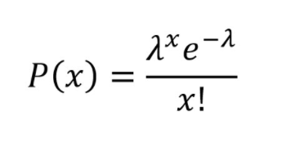
Poisson regression
Very useful when counts are our target.
Probability that we will repeat some note sequnce x times

Slide 68
Poisson regression
Very useful when counts are our target.
lambda is what our
network is predicting.
But also expected value of that distribution
Probability that we will repeat some note sequnce x times

Slide 69
baseline 3
Now we will use this representation:
n50 t4 n55 t1 n59 t2 w t2 n57 t2 w t2 n52 t4 n57 t4 n60 t4 w t4
With this representation amount of possible words in dictonary is very limited. We have 88 notes + wait token + 256 time tokens.

Slide 70
baseline 3
Now we will use this representation:
n50 t4 n55 t1 n59 t2 w t2 n57 t2 w t2 n52 t4 n57 t4 n60 t4 w t4
With this representation amount of possible words in dictonary is very limited. We have 88 notes + wait token + 256 time tokens.
We can compress it to something like that:
n50:t4 n55:t1 n59:t2 w:t2 n57:t2 w:t2 n52:t4 n57:t4 n60:t4 w:t4
Now we have much more words but sequences contains 2 times less words!!

Slide 71
baseline 3
Now we will use this representation:
n50 t4 n55 t1 n59 t2 w t2 n57 t2 w t2 n52 t4 n57 t4 n60 t4 w t4
With this representation amount of possible words in dictonary is very limited. We have 88 notes + wait token + 256 time tokens.
And we can treat this problem as typical classification with just one correct answer at each timestep!

Slide 72
And the winner is...
n50:t4 n55:t1 n59:t2 w:t2 n57:t2 w:t2 n52:t4 n57:t4 n60:t4 w:t4

Slide 73
Training it with GPT
Andrej Karpathy min GPT implementation
140,000 midi songs from LAKH dataset.
Music representation: n50:t4 n55:t1 n59:t2 w:t2 n57:t2 w:t2 n52:t4 n57:t4 n60:t4 w:t4

Slide 74
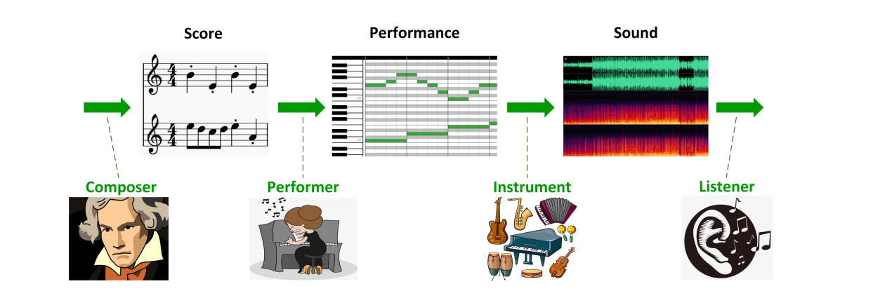
We've just entered the rabit hole...
We are here, ane we
discussed it very briefly.

Slide 75
Limitations and possible solutions
Our model is not aware of bars in music - just enrich our language with <BAR_START> and <BAR_END>

Slide 76
Limitations and possible solutions
Our model is not aware of bars in music - just enrich our language with <BAR_START> and <BAR_END>
Only one instrument (track) - encode each track separately separate them with <TRACK_START> <TRACK_ENDS>

Slide 77
Limitations and possible solutions
Our model is not aware of bars in music - just enrich our language with <BAR_START> and <BAR_END>
Only one instrument (track) - encode each track separately separate them with <TRACK_START> <TRACK_ENDS>
note velocity is not considered - add special word v denoting the velocity.

Slide 78
Limitations and possible solutions
MIDI songs don't feel like a human playing - learn another network to perform MIDI -> plausible audio.

Slide 79
Limitations and possible solutions
MIDI songs don't feel like a human playing - learn another network to perform MIDI -> plausible audio.
We don't have MIDI of all songs - learn another network that will convert raw audio to MIDI.

Slide 80
Limitations and possible solutions
MIDI songs don't feel like a human playing - learn another network to perform MIDI -> plausible audio.
We don't have MIDI of all songs - learn another network that will convert raw audio to MIDI.
Wave2Midi2Wave

Slide 81
Limitations and possible solutions
Songs are generated sequentially here which is quite slow - generate entire sequence in parallel (GANSynth)

Slide 82
Limitations and possible solutions
Songs are generated sequentially here which is quite slow - generate entire sequence in parallel (GANSynth)
We are restricted to sample each note from multinomial distribution - use VAE or GAN's that can use latent space.

Slide 83
Thank you!

